Slide 1
Stock data analysis
Student: Kalybay Zhangylay
Class: Financial Engineering

Slide 2
Content
Stock dataset
Daily stock Prices
Scatter plot and beta
R-squared
Regression Analysis
Correlation Matrix
Volatility
Conclusion

Slide 3
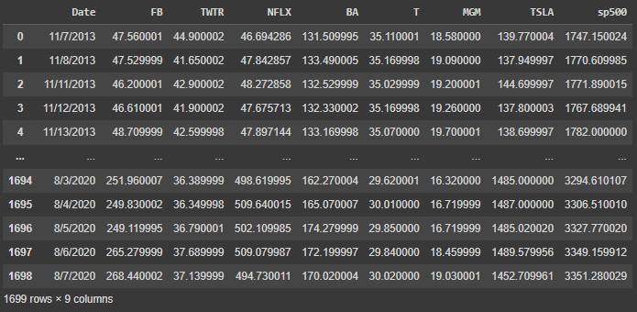
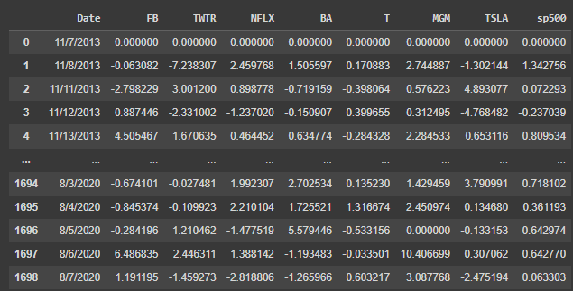
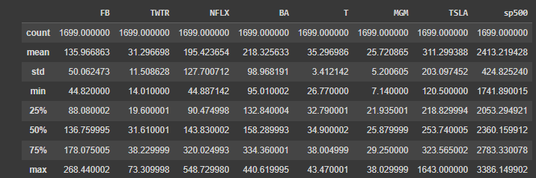
Stocks dataset
Stocks Data
The dataset includes stock prices for several companies along with the S&P 500 index values, dated from November 7, 2013.
To analyze how well the S&P 500 index (as a proxy for the market) explains the returns of a particular stock, we can pick a stock, calculate the daily returns, and then perform a regression analysis.
Stocks Daily Return
Stocks Dataset description

Slide 4
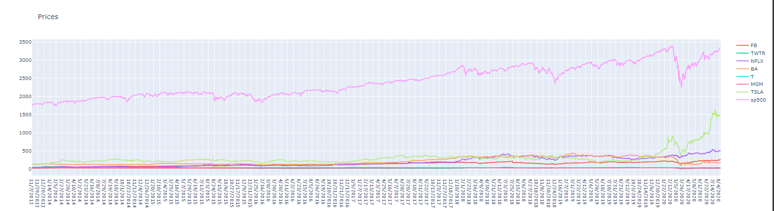
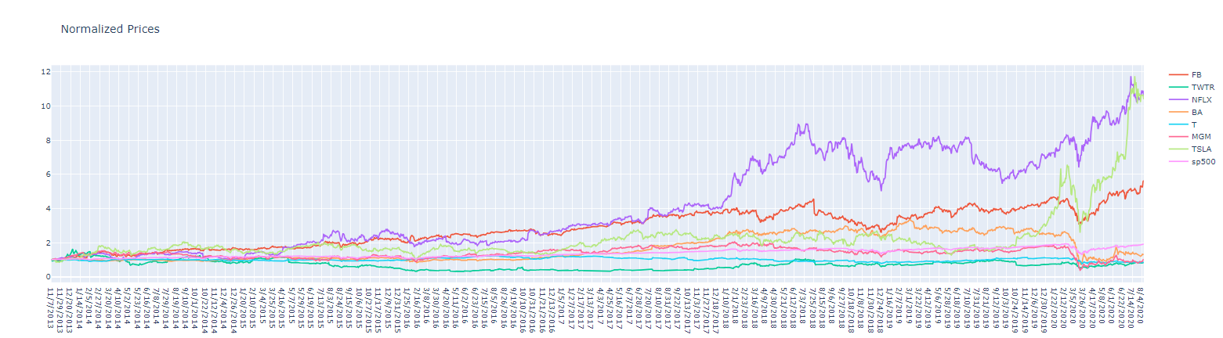
Daily Stock Prices

Slide 5
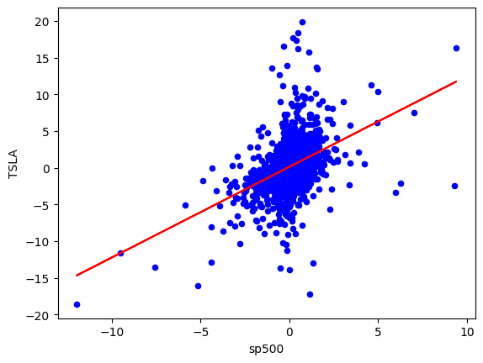
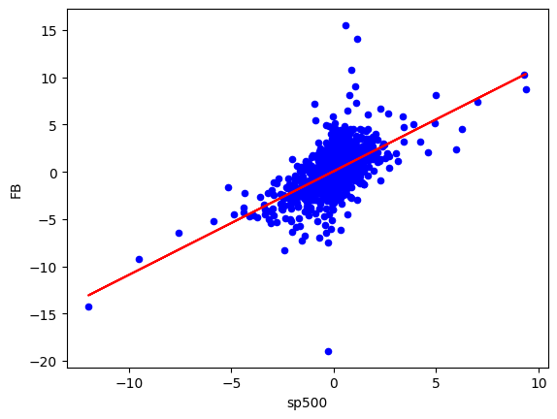
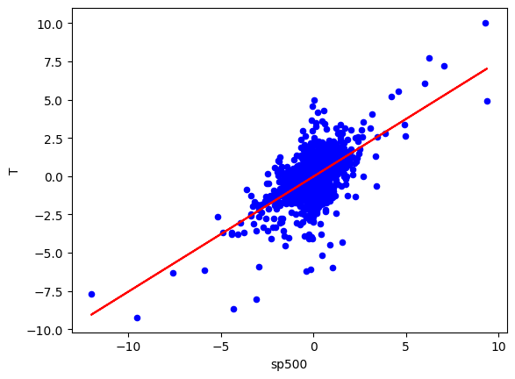
Scatter plot between the selected stock and the S&P500
{'FB': 1.096849088020326, 'TWTR': 1.172359618315995, 'NFLX': 1.0445724485449472, 'BA': 1.4304608163084231, 'T': 0.7523861924715606, 'MGM': 1.6517124147928917, 'TSLA': 1.2359723602006576}
Beta represents the slope of the line regression line (market return vs. stock return).
Beta is a measure of the volatility or systematic risk of a security or portfolio compared to the entire market (S&P500)
Beta is used in the CAPM and describes the relationship between systematic risk and expected return for assets

Slide 6
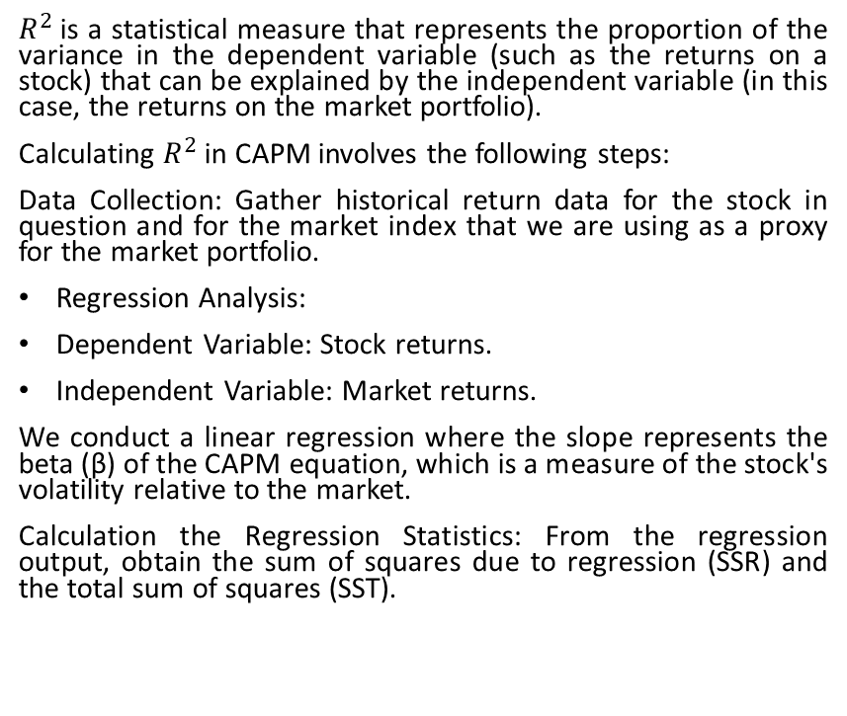

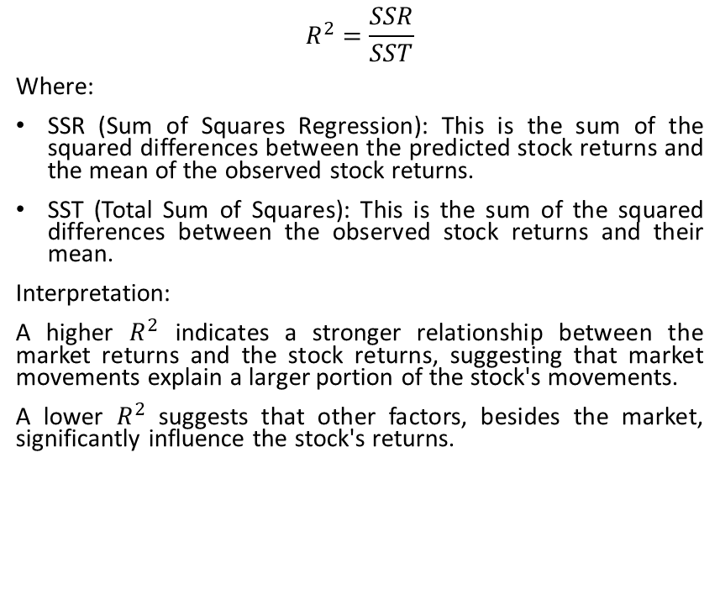
$R^{2}$value
$R^{2}$is a statistical measure that represents the proportion of the variance in the dependent variable (such as the returns on a stock) that can be explained by the independent variable (in this case, the returns on the market portfolio).
Calculating $R^{2}$ in CAPM involves the following steps:
Data Collection: Gather historical return data for the stock in question and for the market index that we are using as a proxy for the market portfolio.
Regression Analysis:
Dependent Variable: Stock returns.
Independent Variable: Market returns.
We conduct a linear regression where the slope represents the beta (β) of the CAPM equation, which is a measure of the stock's volatility relative to the market.
Calculation the Regression Statistics: From the regression output, obtain the sum of squares due to regression (SSR) and the total sum of squares (SST).
$$R^{2}=\frac{SSR}{SST}$$
Where:
SSR (Sum of Squares Regression): This is the sum of the squared differences between the predicted stock returns and the mean of the observed stock returns.
SST (Total Sum of Squares): This is the sum of the squared differences between the observed stock returns and their mean.
Interpretation:
A higher $R^{2}$ indicates a stronger relationship between the market returns and the stock returns, suggesting that market movements explain a larger portion of the stock's movements.
A lower $R^{2}$ suggests that other factors, besides the market, significantly influence the stock's returns.

Slide 7
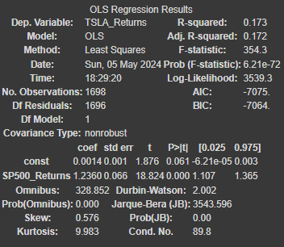
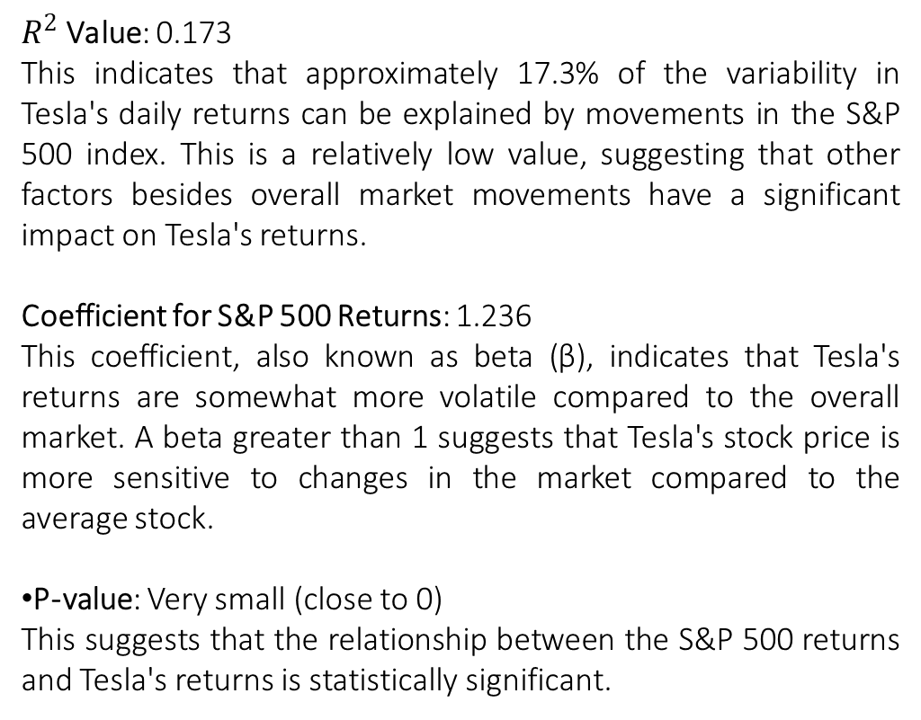
Regression Analysis (TSLA)
$R^{2}$ Value: 0.173
This indicates that approximately 17.3% of the variability in Tesla's daily returns can be explained by movements in the S&P 500 index. This is a relatively low value, suggesting that other factors besides overall market movements have a significant impact on Tesla's returns.
Coefficient for S&P 500 Returns: 1.236
This coefficient, also known as beta (β), indicates that Tesla's returns are somewhat more volatile compared to the overall market. A beta greater than 1 suggests that Tesla's stock price is more sensitive to changes in the market compared to the average stock.
P-value: Very small (close to 0)
This suggests that the relationship between the S&P 500 returns and Tesla's returns is statistically significant.

Slide 8
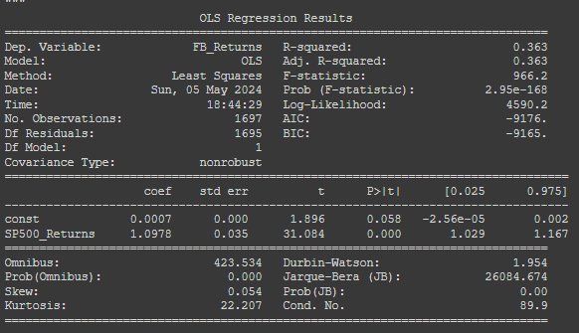
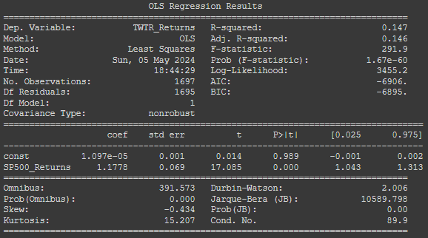
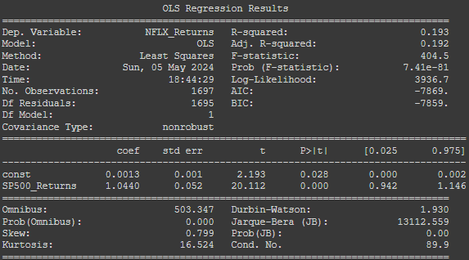
Regression Analysis Facebook (FB), Twitter (TWTR), and Netflix
Facebook (FB)
R2 Value: 0.363
This suggests that about 36.3% of the variability in Facebook's daily returns can be explained by the market's movements.
Beta (β): 1.0978
Facebook has a beta slightly above 1, indicating that its stock is slightly more volatile than the market.
Twitter (TWTR)
R2 Value: 0.221
Approximately 22.1% of the variability in Twitter's daily returns is explained by the market, indicating a moderate level of market influence.
Beta (β): 0.8584
Twitter's beta is less than 1, suggesting that it is less volatile compared to the overall market.
Netflix (NFLX)
R2 Value: 0.193
About 19.3% of the variability in Netflix's daily returns can be attributed to the market.
Beta (β): 1.0440
Netflix has a beta slightly above 1, showing that it is more sensitive to market movements than the average stock.

Slide 9
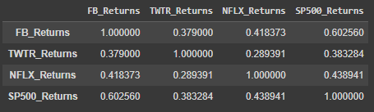
Correlation Matrix
Insights:
FB and S&P 500: A correlation of 0.603 indicates a strong positive relationship between Facebook's returns and the overall market. This suggests that FB's stock movements are quite sensitive to market changes.
NFLX and S&P 500: Netflix also shows a fairly strong correlation with the market at 0.439.
TWTR and S&P 500: Twitter has a moderate correlation with the market at 0.383.
Inter-stock Correlations: The correlations between individual stocks (e.g., FB and NFLX at 0.418) are moderate, suggesting some level of synchronous movement but not as strongly as with the market.

Slide 10

Volatility analysis
Analysis:
Twitter exhibits the highest annualized volatility among the stocks analyzed, indicating it is the most risky in terms of return variability. This higher volatility could be associated with greater unpredictability in its stock price movements.
Netflix also shows relatively high volatility, though less than Twitter, suggesting moderate risk compared to Twitter but still significantly higher than the overall market.
Facebook has lower volatility compared to Twitter and Netflix but still much higher than the S&P 500, indicating a higher risk profile compared to the broader market.
The S&P 500, with the lowest volatility, represents the market benchmark and typically exhibits lower volatility than individual stocks due to diversification across many sectors and companies
The annualized volatility for Facebook (FB), Twitter (TWTR), Netflix (NFLX), and the S&P 500 index:

Slide 11
Conclusion
The analyses suggest that each stock has unique characteristics that could suit different investment strategies. For aggressive investors, Twitter and Netflix might be appealing due to their higher volatilities and potential for significant returns. Conservative investors might prefer Facebook, which, while still volatile, shows a steadier market correlation and growth trend. The S&P 500 serves as a benchmark for comparing these stocks' performances and understanding their movements in the context of the broader market.

